Slide 1
ROC Analysis of Diagnostic Tests BSTT 538 Class Presentation, UIC
Background and Rationale
Concept and Application
Further Reading
Shujun Xu, MS Candidate in Biostatistics
Epidemiology and Biostatistics, School of Public Health
University of Illinois at Chicago
December 6, 2019
Shujun Xu, SPH, UIC
ROC Analysis 1 / 26

Slide 2
Table of Contents
Background and Rationale
Concept and Application
Further Reading
1
Background and Rationale
Concept and Application
Further Reading
2
3
Shujun Xu, SPH, UIC
ROC Analysis 2 / 26

Slide 3
Origin of the Term
Background and Rationale
Concept and Application
Further Reading
The term Receiver Operating Characteristic has its roots in World War II. ROC curves were originally developed by the British as part of the “Chain Home” radar system. ROC analysis was used to analyze radar data to differentiate between enemy aircraft and signal noise (e.g. flocks of geese). As the sensitivity of the receiver increased, so did the number of false positive (in other words, specificity wend down).
Shujun Xu, SPH, UIC
ROC Analysis 3 / 26
Notes:
“Chain Home” radar system is the first early warning radar network in the world, and the fist military radar system to reach operational status.

Slide 4
Timeline of Application
Background and Rationale
Concept and Application
Further Reading
Originated in the early 1950’s with electronic Signal Detecting Theory (SDT)
Introduced to psychology in the early 1950’s
Adapted into diagnostic radiology and radionuclide imaging in early 1960’s
Has been used in medicine, biometrics, forecasting of natural hazards, meteorology, model performance assessment, and other areas for many decades and is increasingly used in machine learning and data mining research.
Shujun Xu, SPH, UIC
ROC Analysis 4 / 26

Slide 5
Signal Detection Theory (SDT)
Background and Rationale
Concept and Application
Further Reading
SDT is a means to measure the ability to differentiate between information-bearing patterns (called stimulus in living organisms, signal in machines) and random patterns that distract from the information (called noise, consisting of background stimuli and random activity of the detection machine and of the nervous system of the operator).
Basic concepts include : Hits, False Alarms, Criterion, ROC curves , and d’.
Shujun Xu, SPH, UIC
ROC Analysis 5 / 26
Notes:
Reading in a coffee shop, you see someone who looks familiar. Have you met him before? This a an example of detection processes.
A common dimension of this situation is that there is uncertainty about whether a signal is present or not. That is, have you met the person before or not? Should you go and talk to him at the risk of embarrassment if you then realize he’s a stranger? Or should you pretend to ignore him at the risk of offending this friend? Both paths of action have potential costs and benefits and the correct decision is not clear.
Furthermore, the decision you make might be biased by your own previous experience. For example, if in the past you were embarrassed when you accidentally waved ‘Hello’ to a stranger, you might be less likely to wave to the person who looks somewhat familiar.

Slide 6
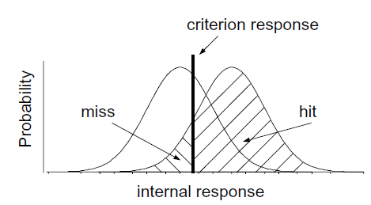
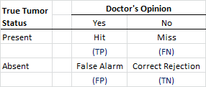
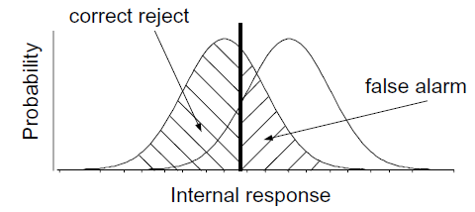
Signal Detection Theory (SDT) - Illustration
Background and Rationale
Concept and Application
Further Reading
Medical Scenario : A radiologist examining a CT scan
Two main components to
the decision-making process :
Information acquisition and criterion
Noise-alone
Signal-plus-noise
Shujun Xu, SPH, UIC
ROC Analysis 6 / 26
Notes:
Information on acquisition: First, there is information in the CT scan. For example, healthy lungs have a characteristic shape. The presence of a tumor might distort that shape. Tumors may have different image characteristics: brighter or darker, different texture, etc.
Criterion: The second component of the decision process is quite different. For, in addition to relying on technology/testing to provide information, the medical profession allows doctors to use their own judgement. Different doctors may feel that the different types of errors are not equal.
External noise: There are many possible sources of external noise. There can be noise factors that are part of the photographic process, a smudge, or a bad spot on the film. Or something in the person's lung that is fine but just looks a bit like a tumor.
Internal noise: Internal noise refers to the fact that neural responses are noisy. Even when there is no tumor present (no-signal trials) there will be some internal response (sometimes more, sometimes less) in the doctor's sensory system.
Notice we never lose the noise.

Slide 7
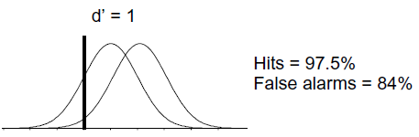
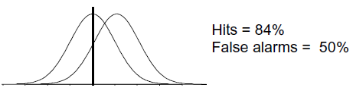
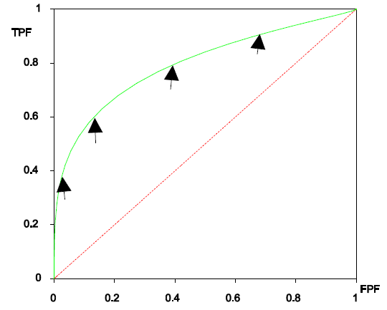
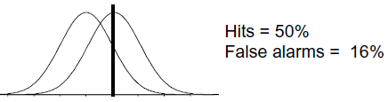
Signal Detection Theory (SDT) – ROC Curve
Background and Rationale
Concept and Application
Further Reading
The Role of the Criterion
We can describe the full range of the doctor’s opinions in a single curve, called an ROC curve.
Hit Rate
False Alarm Rate
Shujun Xu, SPH, UIC
ROC Analysis 7 / 26
Notes:
If the criterion is very high, then both the false alarm rate and the hit rate will be very low, putting you somewhere near the lower left corner of the ROC graph.
If the criterion is very low, then both the hit rate and the false alarm rate will be very high, putting you somewhere near the upper right corner of the graph.
For an intermediate choice of criterion, the hit rate and false alarm rate will take on intermediate values.
The ROC curve characterizes the choices available to the doctor. They may set the criterion anywhere, but any choice that they make will land them with a hit and false alarm rate somewhere on the ROC curve.
Notice also that for any reasonable choice of criterion, the hit rate is always larger than the false alarm rate, so the ROC curve is bowed upward.

Slide 8
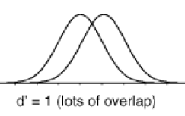
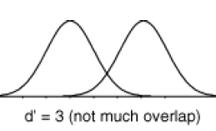
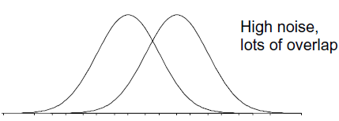
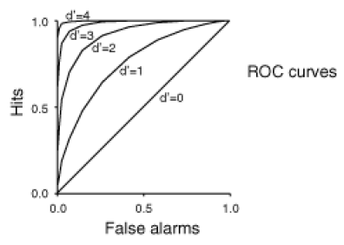
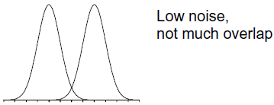
Signal Detection Theory (SDT) – Discriminability Index (d’)
Background and Rationale
Concept and Application
Further Reading
The Role of Information
d’ = separation / spread
Its value does not depend upon the criterion.
Discriminability is made easier either by increasing the separation (stronger signal) or by decreasing the spread (less noise) . In either case, there is less overlap between the curves.
Varying Noise
Shujun Xu, SPH, UIC
ROC Analysis 8 / 26
Notes:
The role of information: Acquiring more information makes the decision easier. When the signal is stronger there is more separation between the two probability of occurrence curves. When this happens the subject's choices are not so difficult as before. ROC curves for stronger signals bow out further than ROC curves for weaker signals. Ultimately, if the signal is really strong (lots of information), then the ROC curve goes all the way up to the upper left corner (all hits and no false alarms).
Varying the noise: Less noise reduces the spread of the curves. So the subject would have an easier time setting their criterion in order to be right nearly all the time.
Discriminability index (d'): The discriminability of a signal depends both on the separation and the spread of the noise-alone and signal-plus-noise curves. But how do we measure d'? The trick is that we have to measure both the hit rate and the false alarm rate ,then we can read-off d' from an ROC curve. Each of these curves(shown in the figure) corresponds to a different d-prime value; d'=0, d'=1, etc. As the signal strength increases, the internal response increases, the ROC curve bows out more, and d' increases. So let's say that we do a detection experiment; we ask our doctor to detect tumors in 1000 CT scans. Some of these patients truly had tumors and some of them didn't. We only use patients who have already had surgery (biopsies) so we know which of them truly had tumors. We count up the number of hits and false alarms. And that drops us somewhere on this plot, on one of the ROC curves. Then we simply read off the d' value corresponding to that ROC curve. Notice that we need to know both the hit rate and the false alarm rate to get the discriminability index, d'.

Slide 9

Measures of diagnostic accuracy – simple statistics
Background and Rationale
Concept and Application
Further Reading
Conventionally a two-by-two confusion matrix (also called contingency table) can be constructed in the case of a binary predictor.
Sensitivity = Ture Positive Rate = TP/(TP+FN) = 1-FNR
Specificity = Ture Negative Rate = TN/(TN+FP) = 1-FPR
Positive Predictive Value (PPV) = TP/(TP+FP)
Negative Predictive Value(NPV) = TN(TN+FN)
Likelihood Ratio = Sensitivity / (1-Specificity)
(Note: LR is independent of prevalence of the disease, LR=1 indicates that the test result is equally likely in patients with and without the disease)
Shujun Xu, SPH, UIC
ROC Analysis 9 / 26
Notes:
The purpose of a diagnostic test is to classify or predict the presence or absence of a disease. The clinical performance of a diagnostic test is based on its ability to correctly classify subjects into relevant subgroups.
The magnitude of the LR informs about the certainty of a positive diagnosis. As a general guideline, a value of LR=1 indicates that the test result is equally likely in patients with and without the disease, values of LR>1 indicate that the test result is more likely in patients with the disease and values of LR<1 indicate that the test result is more likely in patients without the disease.

Slide 10
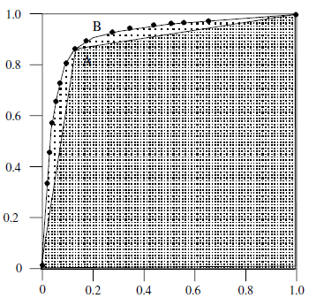
Measures of diagnostic accuracy – ROC Curve
Background and Rationale
Concept and Application
Further Reading
Evaluating the discriminating power of the diagnostic test can be achieved by a ROC curve in the case of predictors measured on a continuous or ordinal scale. A ROC graph depicts relative trade-offs between benefits (TP) and costs (FP).
A “separator” (or decision) variable
Discrete classifiers and scoring classifiers
ROC Space (diagonal line=chance level)
Slope at any point (=LR)
AUC (Area Under the Curve)
C (0,1)
F
D
True Positive Rate
G
E
False Positive Rate
Shujun Xu, SPH, UIC
ROC Analysis 10 / 26
Notes:
The concept of an ROC curve is based on the notion of a "separator" (or decision) variable. The frequencies of positive and negative results of the diagnostic test will vary if one changes the "criterion" or "cut-off" for positivity on the decision axis. Where the results of a diagnostic system are assessed based on subjective judgement, the decision scale is only "implicit". Such a decision variable is often called a "latent" or unobservable variable.
Classifier: A discrete classifier is one that outputs only a class label(such as decision trees or rule sets, are designed to produce only a class decision, i.e., a Y or N on each instance). Each discrete classifier produces an (fp rate, tp rate) pair corresponding to a single point in ROC space. Some classifiers, such as a Naive Bayes classifier or a neural network, naturally yield an instance probability or score, a numeric value that represents the degree to which an instance is a member of a class. Such a ranking or scoring classifier can be used with a threshold to produce a discrete (binary) classifier: if the classifier output is above the threshold, the classifier produces a Y, else a N. Each threshold value produces a different point in ROC space.
ROC SPACE:
The diagonal line y = x represents the strategy of randomly guessing a class. Thus a random classifier will produce a ROC point that ‘slides’back and forth on the diagonal based on the frequency with which it guesses the positive class.
Any classifier that appears in the lower right triangle performs worse than random guessing. This triangle is therefore usually empty.
The point (0, 1) represents perfect classification.
Informally, one point in ROC space is better than another if it is to the northwest of the first.
Classifiers appearing on the left-hand side of an ROC graph, near the X axis, may be thought of as ‘conservative’: they make positive classifications only with strong evidence so they make few false positive errors, but they often have low true positive rates as well. Classifiers on the upper right-hand side of an ROC graph may be thought of as ‘liberal’: they make positive classifications with weak evidence so they classify nearly all positives correctly, but they often have high false positive rates.

Slide 11
AUC and Hypothesis Testing
Background and Rationale
Concept and Application
Further Reading
The AUC can be interpreted as the probability that a randomly chosen diseased subject is rated or ranked as more likely to be diseased than a randomly chosen non-diseased subject. The other interpretation is the average value of sensitivity for all the possible values of specificity. “In a summary sense, the greater the area under the ROC curve, the better the predictions.”
Identical to the value of another measure of predictive power, the concordance index (C-statistic); Calculation based on nonparametric Mann-Whitney U statistics; Equivalent to the Wilcoxon test of ranks (Henley and McNeil, 1982)
Closely related to the Gini coefficient (Breiman et al., 1984) ;
Gini +1 = 2 x AUC (Hand and Till, 2001)
Shujun Xu, SPH, UIC
ROC Analysis 11 / 26
Notes:
The Gini index or Gini coefficient is a statistical measure of distribution developed by the Italian statistician Corrado Gini in 1912. It is often used as a gauge of economic inequality, measuring income distribution or, less commonly, wealth distribution among a population.
(Example) AUC = 0.89 suggests an 89% chance that the radiologist reading the image will correctly distinguish a normal from an abnormal patient based on the ordering of the image ratings. However, in the event of a tied rating, the assumption is that the radiologist will randomly assign one patient as normal and the other as abnormal.

Slide 12
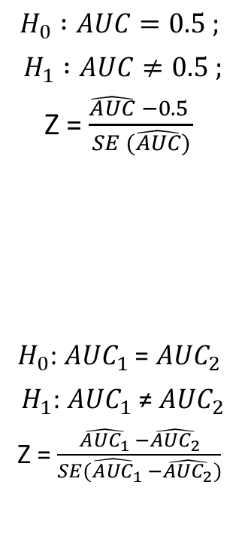
AUC and Hypothesis Testing
Background and Rationale
Concept and Application
Further Reading
In general, a value of 0.5 for AUC indicates that the ROC curve will fall on the diagonal and hence suggests that the diagnostic test has no discriminatory ability; An AUC at 0.7 to 0.8 is considered acceptable, 0.8 to 0.9 is considered excellent, and more than 0.9 is considered outstanding.
Testing the accuracy in comparative study of two diagnostic tests: Correlated ROC curves (same subjects) and Uncorrelated ROC (subjects from different groups)
Shujun Xu, SPH, UIC
ROC Analysis 12 / 26
Notes:
ROC curves generated using data from patients where each patient is subjected to two (or more) different diagnostic tests of interest are considered as correlated ROC curves. ROC curves generated using data from different groups of patients where patients within each group is subjected to two different diagnostic tests are referred as uncorrelated ROC curves.
The comparison of two uncorrelated ROC curves is relatively simple and is based on a form of a Z statistic that uses the difference in the area under the two curves and the SD of each AUC.
In the case of correlated ROC curves, we refer the readers to a nonparametric approach proposed by DeLong et al.
- DeLong ER, DeLong DM, Clarke-Pearson DL. Comparing the areas under two or more correlated receiver operating characteristic curves: a
nonparametric approach. Biometrics. 1988;44:837– 845.

Slide 13
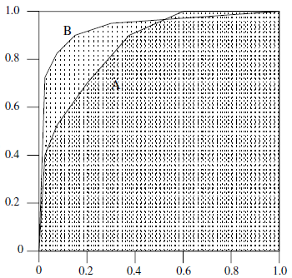
Comparison of Two or More Diagnostic Systems
Background and Rationale
Concept and Application
Further Reading
Three important commonly used indices :
AUC : desirable to compare the entire ROC curve rather than at a particular point
Partial Area Index : a partial area under the curve corresponding to a clinical relevant FPR is recommended as an index of choice (the right side of the unit square is of no clinical relevance)
TPR for a given FPR : especially in the case where two ROC curves cross and the area under the curves may be equal.
True Positive Rate
False Positive Rate
Shujun Xu, SPH, UIC
ROC Analysis 13 / 26
Notes:
It is possible for a high-AUC classifier to perform worse in a specific region of ROC space than a low-AUC classifier. Fig. shows an example of this: classifier B is generally better than A except at FP-rate > 0.6 where A has a slight advantage. But in practice the AUC performs very well and is often used when a general measure of predictive-ness is desired.

Slide 14
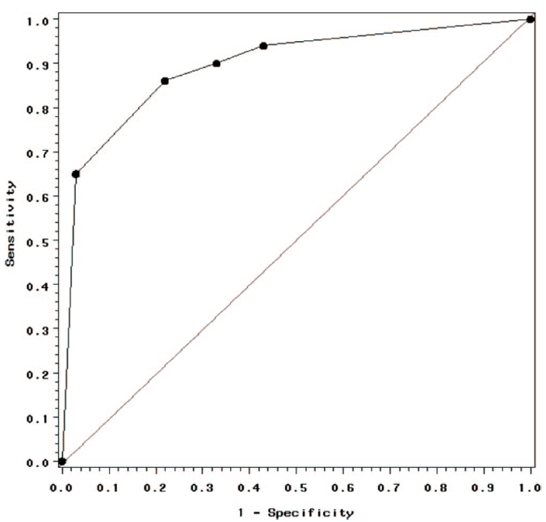
Optimal Cut-off value
Background and Rationale
Concept and Application
Further Reading
In determining optimal cut off values, at least three methods have been proposed:
1. Minimize d²= (1-TPR)²+ FPR²
2. Maximize Youden Index =TPR – FPR
3. Incorporates the financial costs for correct and false diagnosis and the costs of further work up for diagnosis.
Shujun Xu, SPH, UIC
ROC Analysis 14 / 26
Notes:
The third method incorporates the financial costs for correct and false diagnosis and the costs of further work up for diagnosis.
In fact, the consequence of each possible test outcome is ascertained to their costs and combining ROC analysis with utility-based decision theory can be used to determine the optimal cut point. For example, given a disease with low prevalence and high cost of false positive diagnosis, the cut-point may be chosen at higher value to maximize specificity while for a disease occurring at high prevalence and missing diagnosis has a serious fatal consequences, a lower cut-point value would be selected to maximize sensitivity.

Slide 15
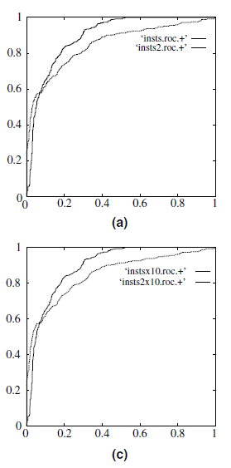
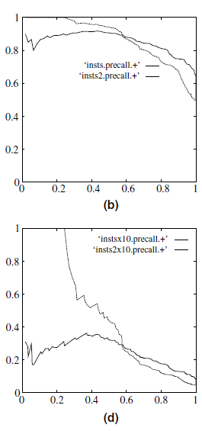
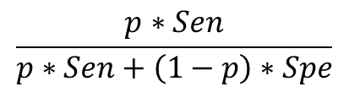
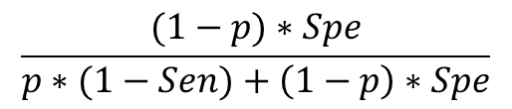
Effect of Class Skew
Background and Rationale
Concept and Application
Further Reading
ROC curves have an attractive property: they are insensitive to changes in class distribution.
Recall: Let p =prevalence of disease
Lower p -> lower PPV , higher NPV
PPV=
NPV=
ROC Curves
PPV – sensitivity curves
Shujun Xu, SPH, UIC
ROC Analysis 15 / 26
Notes:
If the proportion of positive to negative instances changes in a test set, the ROC curves will not change. ROC graphs are based upon tp- rate and fp-rate, in which each dimension is a strict columnar ratio, so do not depend on class distributions.To see the effect of class skew, consider the curves in the figure, which show two classifiers evaluated using ROC curves and precision(PPV)-recall(TPR) curves.
In a and b, the test set has a balanced 1:1 class distribution. Graph c and d shows the same two classifiers on the same domain, but the number of negative instances has been increased 10-fold. Note that the classifiers and the underlying concept has not changed; only the class distribution is different. Observe that the ROC graphs in a and c are identical,while the precision-recall graphs in b and d differ substantially.
(In some cases, the conclusion of which classifier has superior performance can change with a shifted distribution.)

Slide 16
Advantages of ROC Analysis (summary)
Background and Rationale
Concept and Application
Further Reading
ROC curve analysis has several advantages :
In contrast to single measures of sensitivity and specificity, the diagnostic accuracy is not affected by decision criterion and it is also independent of prevalence of disease since it is based on sensitivity and specificity.
Several diagnostic tasks on the same subjects can be compared simultaneously in a ROC space.
One can easily obtain the sensitivity at specific FPR by visualizing the curve.
The optimal cut- off value can be determined using ROC curve analysis.
Shujun Xu, SPH, UIC
ROC Analysis 16 / 26

Slide 17
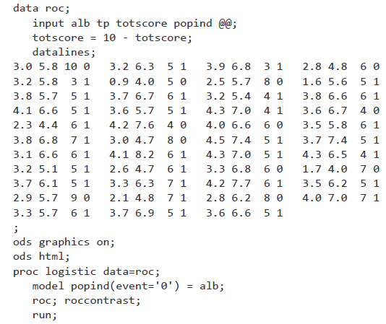
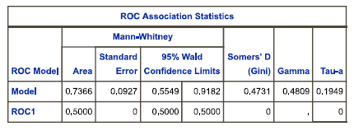

SAS Example (DeLong et al., 1988)
Background and Rationale
Concept and Application
Further Reading
Testing whether the area under the ROC curve differs from 0.5 (chance)
Shujun Xu, SPH, UIC
ROC Analysis 17 / 26
Notes:
You can test the null hypothesis that the area under an ROC curve (AUC) is 0.5 by comparing the model of interest to an intercept-only model. The intercept-only model has area equal to 0.5 and represents a model that performs no better than chance.
Beginning with SAS® 9.2, additional models can be specified in ROC statements and the ROCCONTRAST statement can be used to make comparisons among the models with respect to the areas under their ROC curves. An ROC statement containing no model specification fits the intercept-only model. An ROCCONTRAST statement with no contrast specification compares each additional model in ROC statements with the reference model in the MODEL statement.
About the SAS Example:
DeLong, DeLong, and Clarke-Pearson (1988) report on 49 patients with ovarian cancer who also suffer from an intestinal obstruction. Three (correlated) screening tests are measured to determine whether a patient will benefit from surgery. The three tests are the K-G score and two measures of nutritional status: total protein and albumin.

Slide 18
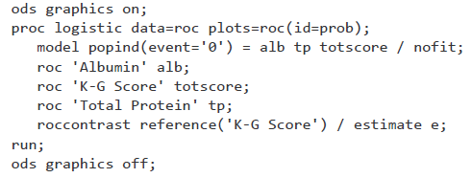
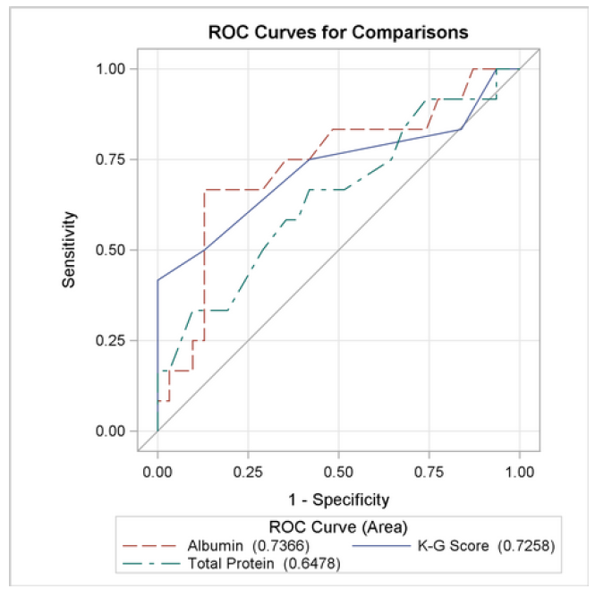
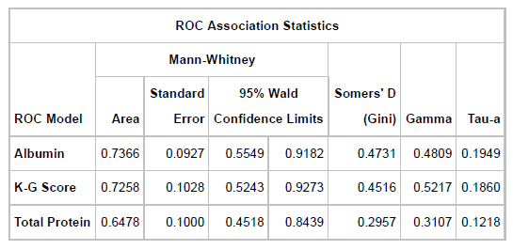
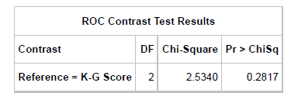
SAS Example (DeLong et al., 1988)
Background and Rationale
Concept and Application
Further Reading
Comparing two or more correlated (dependent) ROC Curves
Shujun Xu, SPH, UIC
ROC Analysis 18 / 26
Notes:
Usage Note 45339: Comparing the areas under independent ROC curves: http://support.sas.com/kb/45/339.html
Issue: “Misuse of DeLong test to compare AUCs for nested models”
Very often, in settings where the model is developed and tested on the same dataset, the added predictor is statistically significantly associated with the outcome but fails to produce a significant improvement in the AUC. No conclusive resolution exists to explain this finding.
In this paper, we will show that the reason lies in the inappropriate application of the DeLong test in the setting of nested models. Using numerical simulations and a theoretical argument based on generalized U-statistics, we show that if the added predictor is not statistically significantly associated with the outcome, the null distribution is non-normal, contrary to the assumption of DeLong test. Our simulations of different scenarios show that the loss of power because of such a misuse of the DeLong test leads to a conservative test for small and moderate effect sizes. This problem does not exist in cases of predictors that are associated with the outcome and for non-nested models.
We suggest that for nested models, only the test of association be performed for the new predictors, and if the result is significant, change in AUC be estimated with an appropriate confidence interval, which can be based on the DeLong approach.
18

Slide 19
Other Issues – In the Absence of a Gold Standard
Background and Rationale
Concept and Application
Further Reading
In medicine and statistics, a gold standard test is usually the diagnostic test or benchmark that is the best available under reasonable conditions. Other times, a gold standard is the most accurate test possible without restrictions.
In order to obtain an unbiased estimator for the test accuracy, the true disease status for each patient (present or absent, and independent of the patient's test result) needs to be determined. The procedure that establishes the patient's true disease status is referred to as a gold standard.
Hall and Zhou (2003) proposed a non-parametric estimator for the ROC curves of continuous-scale tests under the conditional independence assumption when the number of tests is more than two.
Further Reading: Non-Parametric Estimation of ROC Curves in the absence of a Gold Standard (Zhou XH, Castelluccio P, Zhou C., 2004)
Shujun Xu, SPH, UIC
ROC Analysis 19 / 26
Notes:
19

Slide 20
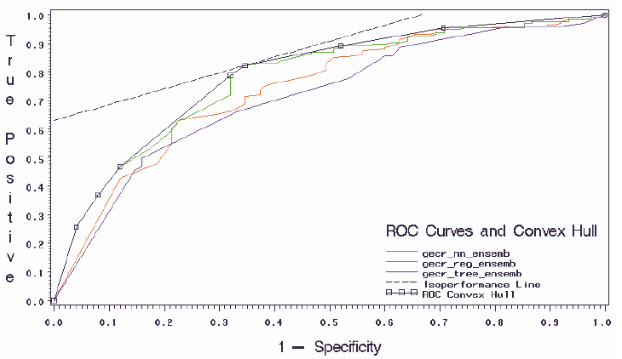

Other Issues – The ROC convex hull (ROCCH)
Background and Rationale
Concept and Application
Further Reading
In search for the optimal classifier that is robust with respect to skewed or imprecise class distributions and disparate misclassification costs, Provost and Fawcett (1998, 2001) show that a set of operating conditions may be transformed easily into a so-called iso-performance line in ROC space.
Two points in ROC space,
(FP1,TP1) and (FP2,TP2),
have the same performance if
All classifiers corresponding to points on a line of slope m have the same expected cost. More generally, a classifier is potentially optimal if and only if it lies on the convex hull of the set of points in ROC space.
Shujun Xu, SPH, UIC
ROC Analysis 20 / 26
Notes:
Cost-Sensitive Classifier Selection Using the ROC Convex Hull Method (Ross Bettinger)
SAS Institute (2000). Getting Started with Enterprise Miner Software, Release 4.1, SAS Institute,Cary, NC. ISBN: 1-58025-153-6.
Abstract : Without additional information describing the cost of a mis-classification, accuracy alone as a selection criterion may not be a sufficiently robust measure when the distribution of classes is greatly skewed or the costs of different types of errors may be significantly different.
The receiver operating characteristic (ROC) curve is often used to summarize binary classifier performance due to its ease of interpretation, but does not include misclassification cost information in its formulation. Provost and Fawcett [5, 7] have developed the ROC Convex Hull (ROCCH) method that incorporates techniques from ROC curve analysis, decision analysis, and computational geometry in the search for the optimal classifier that is robust with respect to skewed or imprecise class distributions and disparate misclassification costs.
We apply the ROCCH method to several datasets using a variety of modeling tools to build binary classifiers and compare their performances using misclassification costs. We support Provost,Fawcett, and Kohavi’s claim [6] that classifier accuracy, as represented by the area under the ROC curve, is not an optimal criterion in itself for choosing a classifier, and that by using the ROCCH method, a more appropriate classifier may be found that realistically reflects class distribution and misclassification costs.
20

Slide 21
Other Issues – Rating Scale Version
Background and Rationale
Concept and Application
Further Reading
Rating scales (also called assessment scale) are used to elicit data about quantitative entities. Often, predictability of rating scales (also called ‘‘assessment scales’’) could be improved.
Rating scales often use values: ‘‘1 to 10’’ and some rating scales may have over 100 items (questions) to rate.
Other popular terms for rating scales are: survey and questionnaire.
Rating itself is very popular on the Internet for ‘‘Customer Reviews’’ where often uses five stars (e.g., by Amazon.com ) instead of ordinal numbers.
Further Reading: How to reduce the number of rating scale items without predictability loss? (Koczkodaj et al., 2017)
Shujun Xu, SPH, UIC
ROC Analysis 21 / 26

Slide 22
Other Issues – Creating Scoring Classifiers
Background and Rationale
Concept and Application
Further Reading
Many discrete classifier models may easily be converted to scoring classifiers by ‘‘looking inside’’ them at the instance statistics they keep.
Even if a classifier only produces a class label, an aggregation of them may be used to generate a score. MetaCost (Domingos, 1999) employs bagging to generate an ensemble of discrete classifiers, each of which produces a vote. The set of votes could be used to generate a score.
Some combination of scoring and voting can be employed. For example, rules can provide basic probability estimates, which may then be used in weighted voting (Fawcett, 2001).
Research Question: Implications of Various “Voting” standards ?
Shujun Xu, SPH, UIC
ROC Analysis 22 / 26
Notes:
22

Slide 23
Other Issues – Multi-reader ROC Analysis
Background and Rationale
Concept and Application
Further Reading
Assume that we are considering diagnostic imaging studies where there are multiple readers (e.g., radiologists) who assign to each case (i.e., patient) a disease severity or disease likelihood rating based on the corresponding image or set of images, acquired using one or more imaging modalities. For studies where there is Reader Variability, the researcher typically will prefer to have conclusions apply to both the reader (can be treated as random sample) and case populations.
Traditionally, multi-reader receiver operating characteristic (ROC) studies have used a “paired-case, paired-reader” design. The Dorfman-Berbaum-Metz (DBM) method has been one of the most popular methods for analyzing multi-reader ROC studies since it was proposed in 1992.
Further Reading: Recent Developments in the Dorfman-Berbaum-Metz Procedure for Multireader ROC Study Analysis (Stephen L. Hillis, Kevin S. Berbaum and Charles E. Metz, 2008)
Shujun Xu, SPH, UIC
ROC Analysis 23 / 26
Notes:
23

Slide 24
REFERENCES
Background and Rationale
Concept and Application
Further Reading
Hajian-Tilaki P. Receiver Operating Characteristic (ROC) Curve Analysis for Medical Diagnostic Test Evaluation. Caspian J Intern Med. 2013; 4(2): 627-635.
Heeger D. Signal Detection Theory. New York University website. https://www.cns.nyu.edu/~david/handouts/sdt/sdt.html. 2003-2007. Accessed December 1, 2019.
Mandrekar J N. Receiver Operating Characteristic Curve in Diagnostic Test Assessment. J Thorac Oncol. 2010; 5:1315–1316.
Mandrekar J N. Simple Statistical Measures for Diagnostic Accuracy Assessment. J Thorac Oncol. 2010; 5: 763–764.
Fawcett T. An introduction to ROC analysis. Pattern Recognition Letters. 2006; 27:861-874. doi:10.1016/j.patrec.2005.10.010.
Shujun Xu, SPH, UIC
ROC Analysis 24 / 26

Slide 25
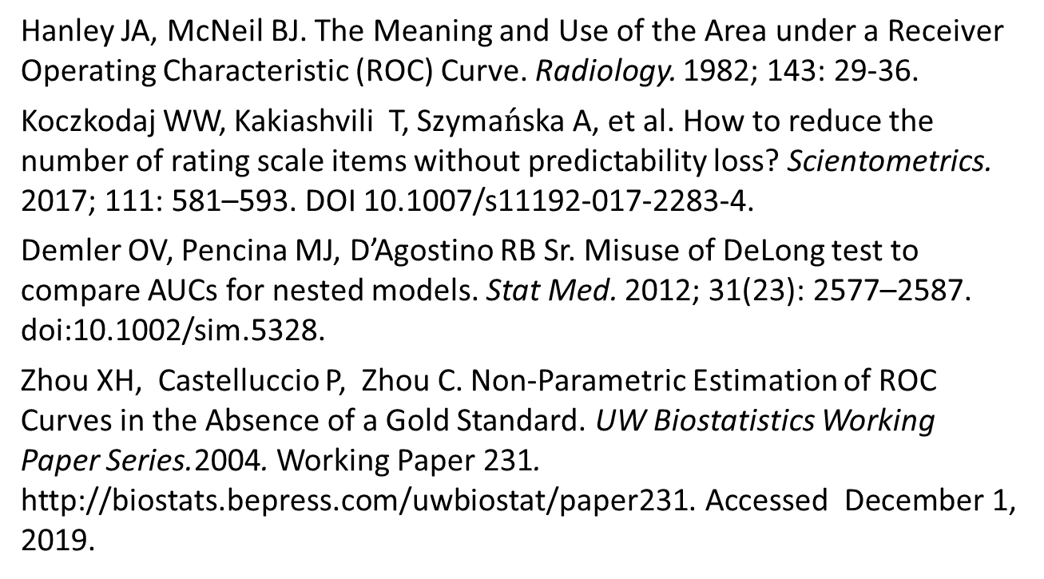
REFERENCES
Background and Rationale
Concept and Application
Further Reading
Hanley JA, McNeil BJ. The Meaning and Use of the Area under a Receiver Operating Characteristic (ROC) Curve. Radiology. 1982; 143: 29-36.
Koczkodaj WW, Kakiashvili T, Szyma$\acute{n}$ska A, et al. How to reduce the number of rating scale items without predictability loss? Scientometrics. 2017; 111: 581–593. DOI 10.1007/s11192-017-2283-4.
Demler OV, Pencina MJ, D’Agostino RB Sr. Misuse of DeLong test to compare AUCs for nested models. Stat Med. 2012; 31(23): 2577–2587. doi:10.1002/sim.5328.
Zhou XH, Castelluccio P, Zhou C. Non-Parametric Estimation of ROC Curves in the Absence of a Gold Standard. UW Biostatistics Working Paper Series.2004. Working Paper 231. http://biostats.bepress.com/uwbiostat/paper231. Accessed December 1, 2019.
Shujun Xu, SPH, UIC
ROC Analysis 25 / 26

Slide 26
REFERENCES
Background and Rationale
Concept and Application
Further Reading
Stephanie. Receiver Operating Characteristic (ROC) Curve: Definition, Example. Statistics How To website. https://www.statisticshowto.datasciencecentral.com/receiver-operating-characteristic-roc-curve/. August 27, 2016. Accessed December 1, 2019.
Wikipedia. Detection theory. Wikipedia website. https://en.wikipedia.org/wiki/Detection_theory#cite_note-3. Accessed December 1, 2019.
Web Interface for Statistics Education. Signal Detection: Overview. WISE website. http://wise.cgu.edu/wise-tutorials/tutorial-signal-detection-theory/signal-detection-overview-2/. Accessed December 1, 2019.
Shujun Xu, SPH, UIC
ROC Analysis 26 / 26

